Slide 1
WEB CACHE POISONING
Aiello Simone - 242469
Camarda Alessia Donata - 242466
Dramisino Cristian Domenico - 247961
Salerno Alessandro - 247233

Slide 2
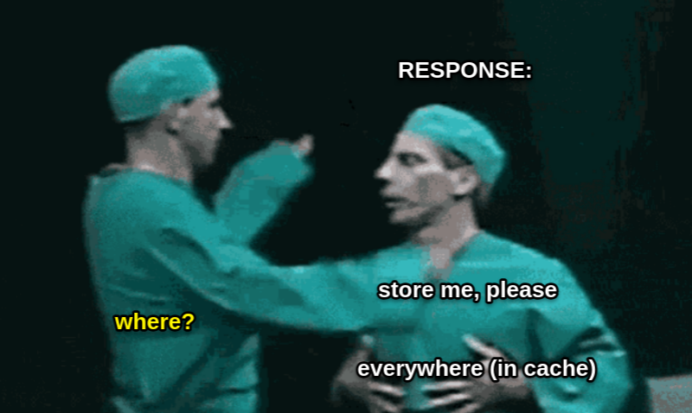
WEB CACHE - HOW DOES IT WORK? (1)
The Web Cache is a mechanism used to reduce the server overload.
It sits between a server and the users, where it caches the responses to requests, for a fixed amount of time.
When an equivalent request is sent, the cache serves a copy of the cached response directly to the user, without any interaction from the back-end.
Notes:
A web cache is a mechanism used to reduce the server overload. Instead of directly asking a new response to the server every time a new request is made by the browser, the responses can be cached for a fixed amount of time and when an equivalent request is sent, the cache serves a copy of the cached response directly to the user and without any interaction with the back-end.

Slide 3
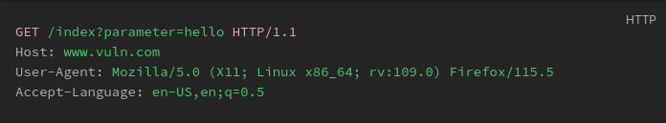
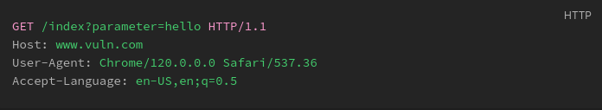
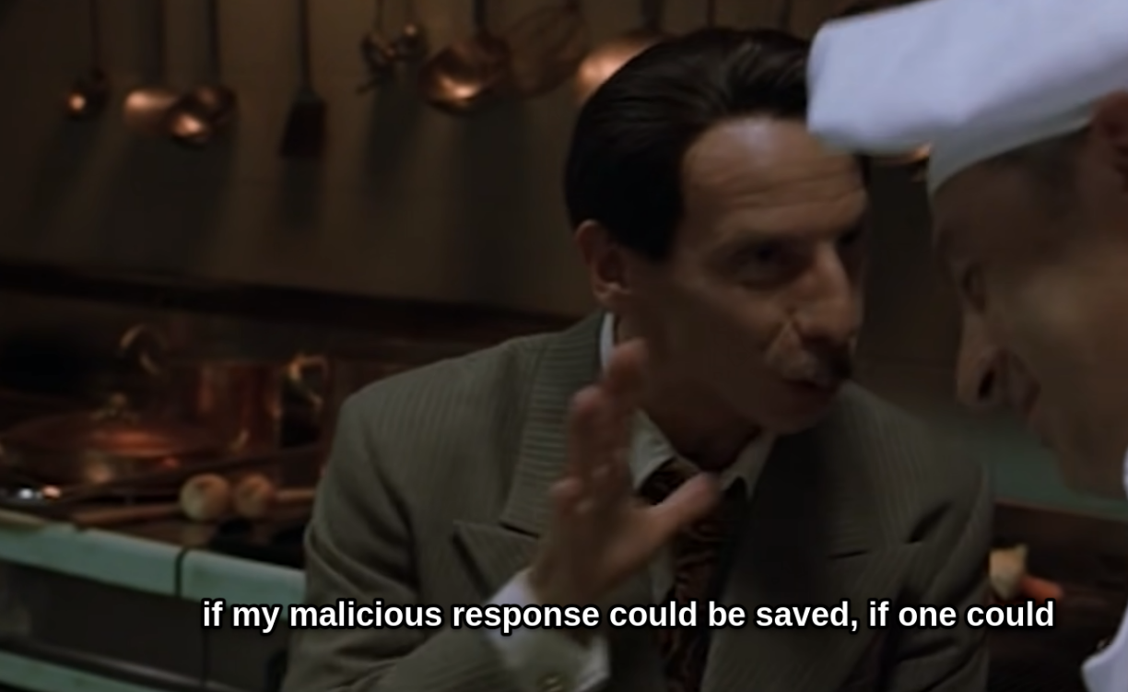
WEB CACHE - HOW DOES IT WORK? (2)
Requests are identified by predefined subset of specific request's components, known as the "cache key".
Typically, the cache key would contain the request line and the Host header.
Components of the request that are not included in the cache key are said to be "unkeyed".
Different requests (different user-agent) but treated as identical (same cache key).
Notes:
[L’oratore dovrà mettere in evidenza cosa sono le cache key]
To identify equivalent requests, we use the cache keys. A cache key is a subset of specific request’s components, usually it includes the request line and some headers, like the Host header. As specified in the slide, components of the request that are not included in the cache key are called unkeyed. Here we can see an example. We have two requests, both with the same http method, same request line, header host and accept language. Anyways there is something different between them, the user agent. Based on how the cache key is generated, this two requests can be considered equivalent or not. In our example, they are equivalent because cache key is composed by the request line and the host header,then the response cached after the first one request can be sent to the client when the second request was made. But if for some reason the cache key had included the user agent too, the requests would have been considered not equivalent.

Slide 4
WHAT IS WEB CACHE POISONING?
01
02
03
Web cache poisoning is an advanced technique whereby an attacker exploits the behavior of a web server and cache so that a harmful HTTP response is served to other users.
The attacker elicit a response from the back-end server that contains dangerous payload.
The response given to the attacker is cached.
The cached response is subsequently served to the intended victims.
HTTP/1.1 200 OK
Cache: hit
X-Forwarded-Host: a."><script>alert(1)</script>"
Notes:
Given this preliminary notion, we can now introduce web cache poisoning. This is an advanced technique in which an attacker exploits the behaviour of the web cache and the web server to serve an harmful http response to the users. In particular, there are three steps in the attack: first, the attacker try to craft and obtain an harmful response from the back-end and when he success, second step, the harmful response is cached. Last step, the injected response is served to the victims without the server really knows what it’s happening. Even here a small example, using some specific header, like my colleagues will show in the following slides, the attacker elicit the response and when he obtains the cache hit, it means that the response is cached and ready for the exploit.

Slide 5
FROM WHAT & CONSEQUENCES
IMPLEMENTATION FLAWS
DESIGN FLAWS
Related to flaws in keys generation.
Related to how unkeyed input are handled.
IMPACT
It depends on which parameters are treated as unkeyed and how the application handles them.
It can be used to deliver client-side attacks, i.e. reflected XSS, without user-interaction.
The severity depends on the amount of traffic on the affected page.
Notes:
How is this attack possible? It is due to some implementation and design flaws, like we have said before, usually it depends on how the cache key is generated but very often the flaw is given by the way in which the input that is not part of the key is handled. In both case, the impact of the attack depends on which parameters are included in the cache key, and on how many people can be reached using that response. It also very important which kind of harmful content the response is carried on, and usually those responses are used to deliver client-side attacks.

Slide 6
01.
LAB 1 - Web cache poisoning via unkeyed query string
Notes:
[CRISTIAN]

Slide 7
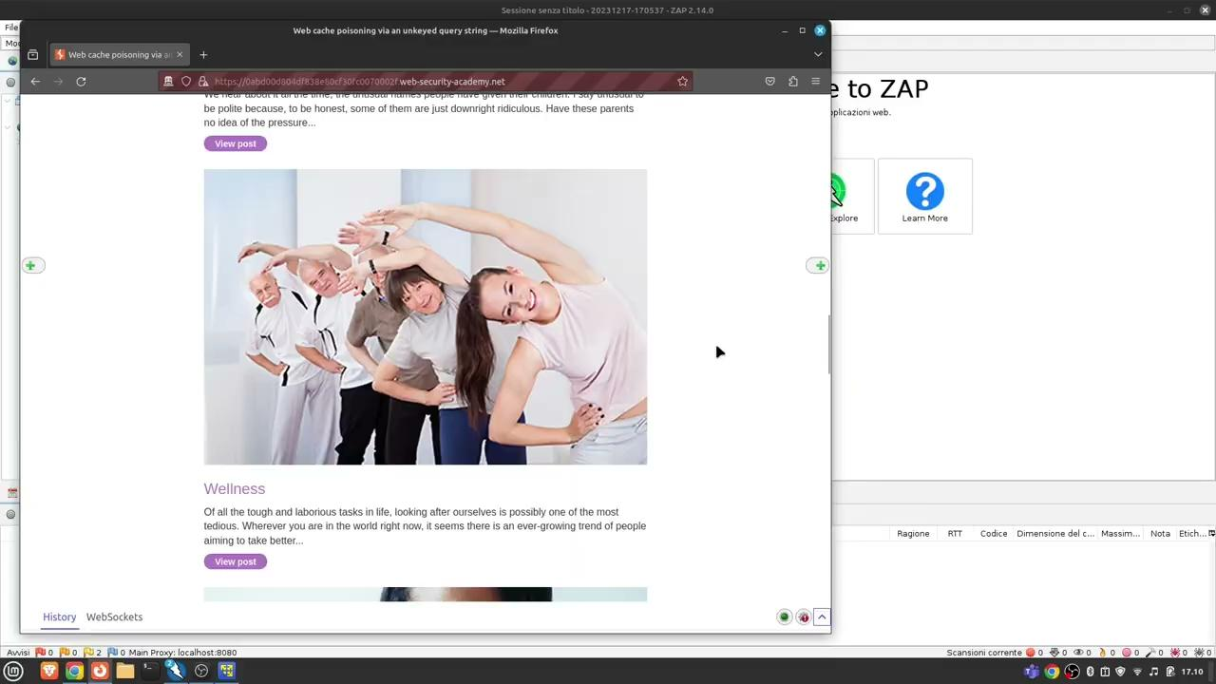

Slide 8
02.
LAB 2 -
DOM vulnerability via a cache with strict cacheability criteria
Notes:
[ALESSANDRO]

Slide 9


Slide 10
03.
LAB 3 - Web cache poisoning with multiple headers
Notes:
[SIMONE]

Slide 12

HOW TO PREVENT
01
02
03
04
Avoid caching, if it is not really needed.
If caching is needed, restrict it to only static responses.
Disable headers that aren’t really needed for the site to work.
Follow these tips when implementing caching:
if you need to exclude something from cache keys then rewrite the entire request.
avoid accepting fat-GET requests.
patch client-side vulnerabilities even if they seem unexploitable, the cache behavior could make them exploitable.
Notes:
[ALESSIA STRONZA]
How can we prevent web cache poisoning?
First of all, if not really necessary we can avoid caching at all.
If caching is really needed, we have to restrict it to only static responses,
In addition we have to disable those headers that aren’t necessary for the website and that can be very dangerous if exploited.
In the end, we have to remember that if something must be excluded from the cache key, then it’s better to rewrite the entire request. (?)
If some client-side vulnerabilities arise, even if they seem unexploitable, using web cache poisoning, they can be exploited, then, better to fix those.
And at the end, better to avoid fat-GET requests that can be exploited when the http method is not keyed.

Slide 13
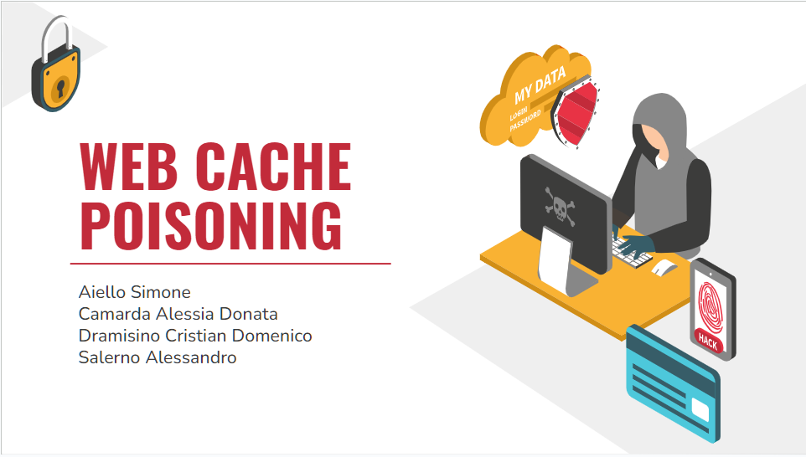
THANKS FOR ATTENTION!

